Slide 1




Patient Simulation

Slide 2
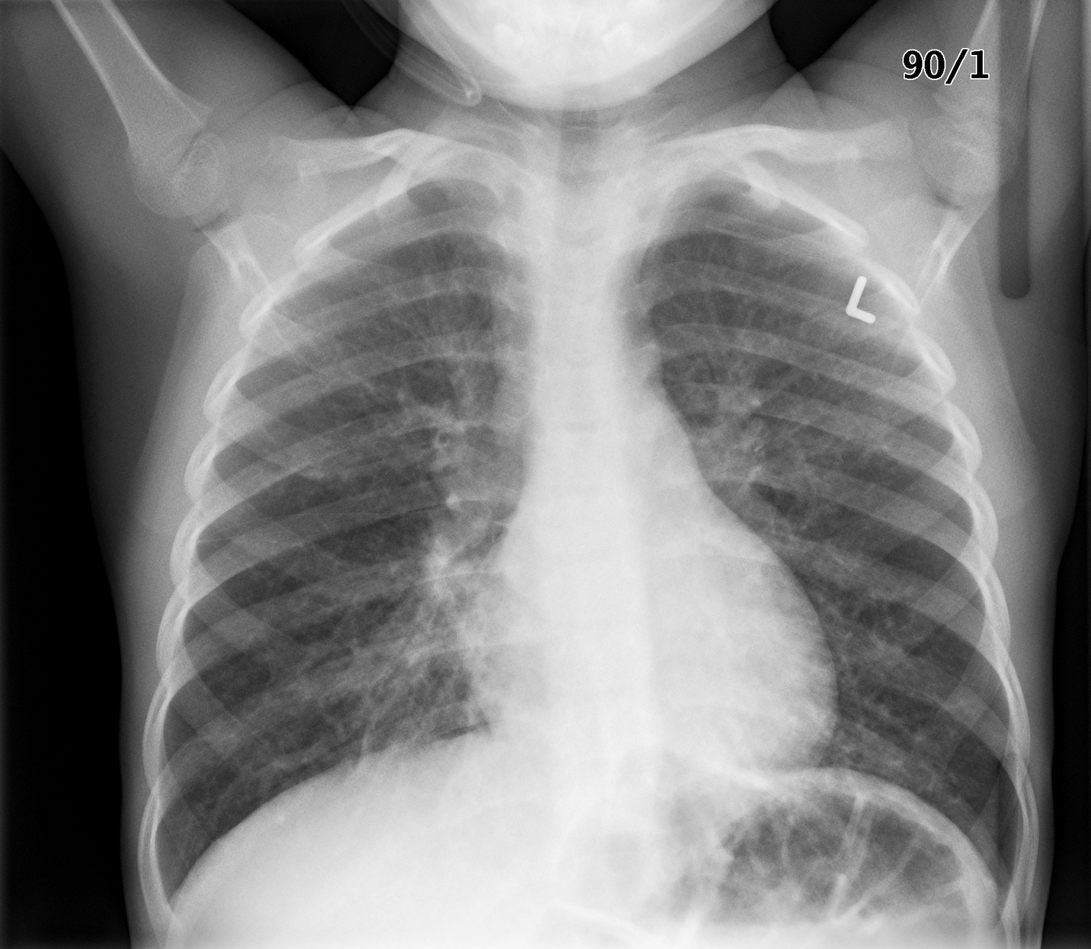

Slide 3
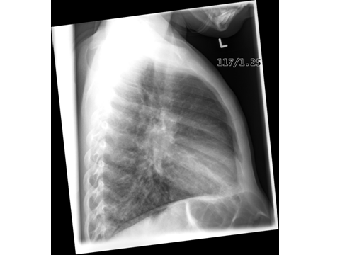

Slide 4
Test | Phase 2 | Flag (H or L) | Reference
CBC
WBC | 33 | H | 3.5 – 10.8 10^9/L
Hgb | 101 | L | 130 – 170 g/L
Platelets | 77 | L | 150 – 400 10^9/L
Fibrinogen | Low normal
D-Dimer | Mildly elevated |  | <250 mcg/L
Chemistry
Na | 132 | L | 137 – 145 mmol/L
K | 4 |  | 3.5 – 5.0 mmol/L
Cl | 111 | H | 98 – 107 mmol/L
Urea | 22 | H | 2.5 – 6.1 mmol/L
Creat | 125 | H | 62 – 106 umol/L
Glucose - Random | 6.5 |  | 3.0 – 11.0 mmol/L
Lactate | 12 | H | 0.9 – 1.8 mmol/L
Coags
INR | 1.3 | H | 0.9 – 1.2
PTT | 52 | H | 28 – 38 s
ABGs
Arterial
pH | 7.08 | L | 7.35- 7.45
pCO2 | 48 | H | 35 – 45 mmHg
PO2 | 62 | L | 80-100 mmHg
BE | -13 |  | -2.0 to +2.0 mmol/L
HCO3 | 10 | L | 22 – 26 mmol/L
O2 Sat |  |  | 95 – 100%

Slide 5
Test | Phase 3 | Flag (H or L) | Reference
Lactate | 14 | H | 0.9 – 1.8 mmol/L
ABGs
Arterial
pH | 7.1 | L | 7.35- 7.45
pCO2 | 49 | H | 35 – 45 mmHg
PO2 | 64 | L | 80-100 mmHg
BE | -8 |  | -2.0 to +2.0 mmol/L
HCO3 | 16 | L | 22 – 26 mmol/L
O2 Sat |  |  | 95 – 100%

Slide 6
