Slide 1




Patient Simulation

Slide 2
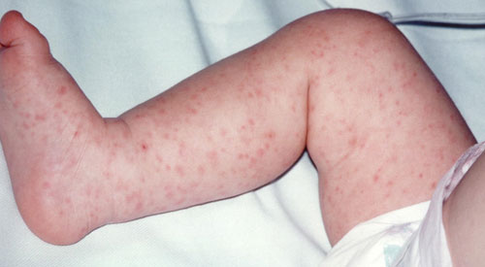

Slide 3
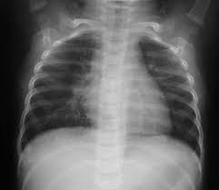

Slide 4
LABORATORY *LIVE* Lab Summary Report
Test | 20/04/2016 0730 |  | Flag (H or L) | Reference
CBC
WBC | 20.1 |  | H | 3.5 – 10.8 10^9/L
Hgb | 143 |  |  | 130 – 170 g/L
Platelets | 612 |  | H | 150 – 400 10^9/L
Chemistry
Na | 140 |  |  | 137 – 145 mmol/L
K | 4 |  |  | 3.5 – 5.0 mmol/L
Cl | 100 |  |  | 98 – 107 mmol/L
HCO3 | 10 |  | L | 22-26 mmol/L
Creat | 100 |  |  | 62 – 106 umol/L
Glucose - Random | 4.4 |  |  | 3.0 – 11.0 mmol/L
Lactate | 6 |  | H | 0.9 – 1.8 mmol/L
Coags
INR | 1.6 |  | H | 0.9 – 1.2
PTT | 50 |  | H | 28 – 38 s
ABGs
Arterial
pH | 7.24 | L |  | 7.35- 7.45
pCO2 | 50 | H |  | 35 – 45 mmHg
HCO3 | 10 | L |  | 22 – 26 mmol/L

