Slide 1




Patient Simulation

Slide 2
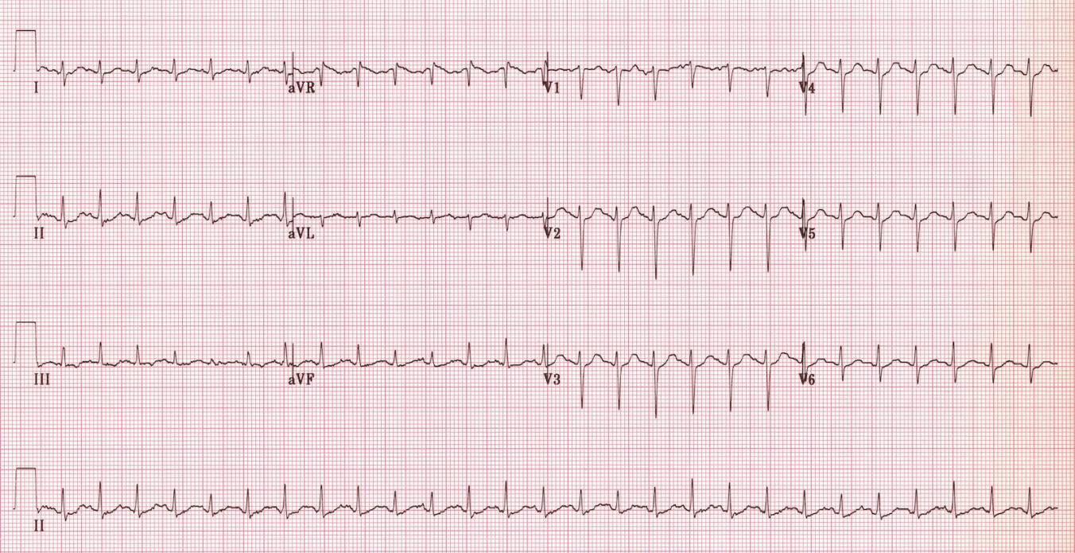

Slide 3
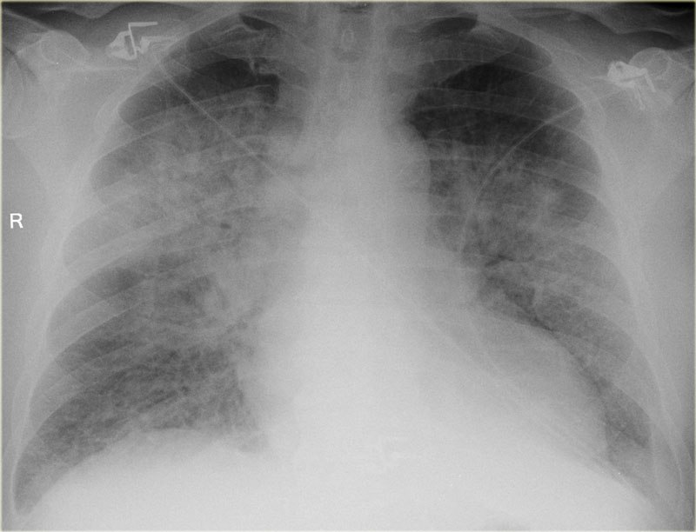

Slide 4
Test | DATE/TIME here | Flag (H or L) | Reference
Arterial Blood Gas
Arterial
pH | 7.33 | L | 7.35- 7.45
pCO2 | 48 | H | 35 – 45 mmHg
PO2 | 89 |  | 80-100 mmHg

Slide 5
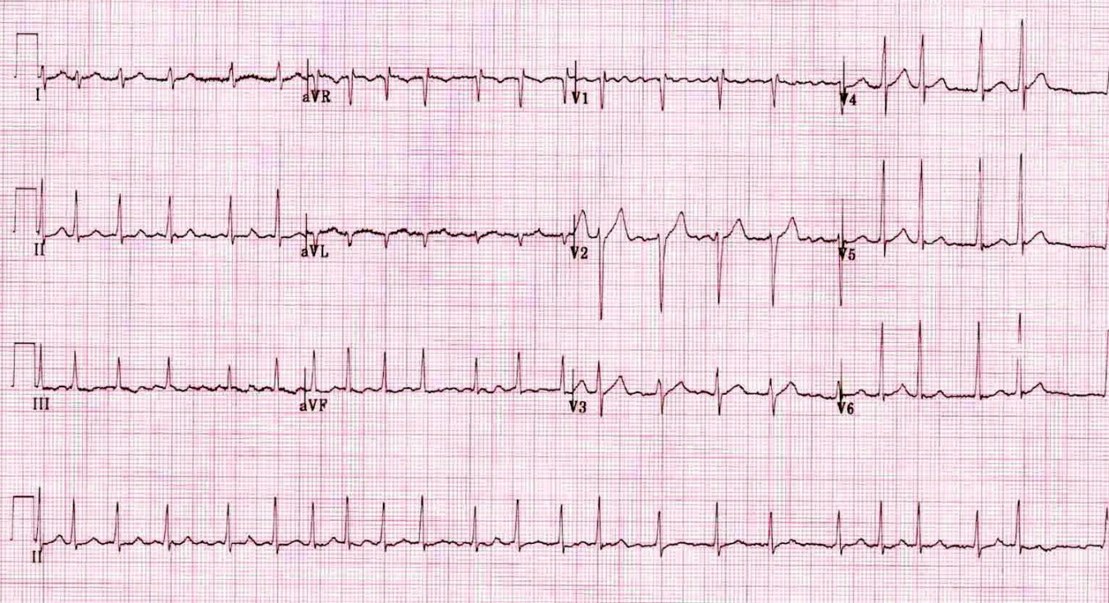

Slide 6
Test | DATE/TIME here | Flag (H or L) | Reference
CBC
WBC | 14.0 | H | 3.5 – 10.8 10^9/L
Hgb | 125 | L | 130 – 170 g/L
Platelets | 450 | H | 150 – 400 10^9/L
Chemistry
Na | 144 |  | 137 – 145 mmol/L
K | 5.0 |  | 3.5 – 5.0 mmol/L
Cl | 109 | H | 98 – 107 mmol/L
HCO3 | 24 |  | 22-26 mmol/L
Urea | 11 | H | 2.5 – 6.1 mmol/L
Creat | 70 |  | 62 – 106 umol/L
Glucose - Random | 6.9 |  | 3.0 – 11.0 mmol/L
Calcium | 2.80 | H | 2.18-2.58 mmol/L
Magnesium | 0.94 |  | 0.75-0.95 mmol/L
TSH | 0.1 | L | 0.4-5.0 mU/L
T3 | Pending |  | 3.5-6.5 pmol/L
T4 | Pending |  | 8.5-15.2 pmol/L

